Slide 1
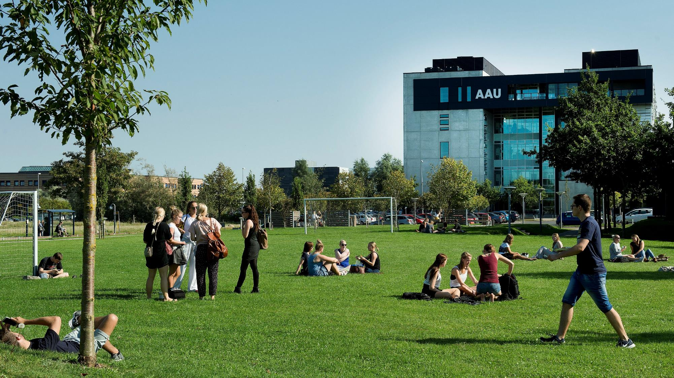
Corona and (Post-) Digital Science
Thomas Ryberg (ryberg@plan.aau.dk)| @tryberg Professor in PBL and Digital Learning
Co-chair – Networked Learning Conference
www.networkedlearning.aau.dk
Also featuring the work of: Jacob Davidsen, Paul McIlvenny, Mia Thyrre Sørensen. Kathrin Otrel-Cass

Slide 2
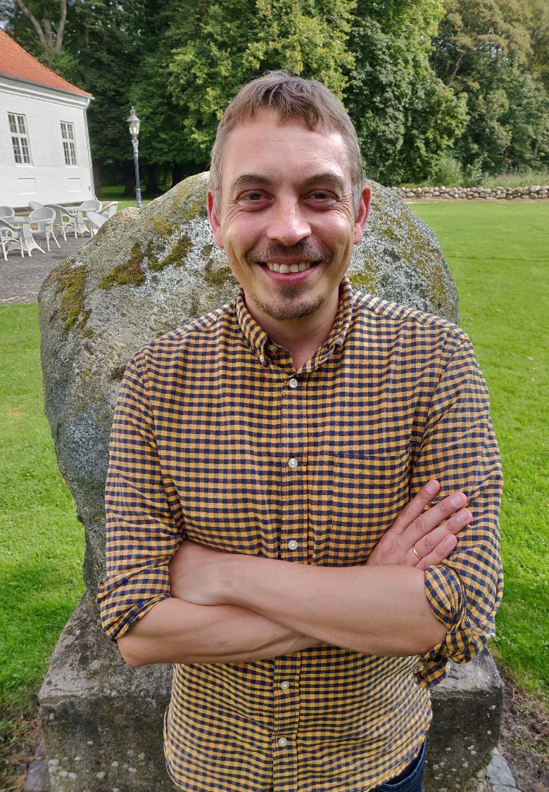
Bio
Professor in PBL and Digital Learning – Department of Planning, Aalborg University
Aalborg Centre for Problem Based Learning in Engineering Science (www.ucpbl.net)
From 1st January – Director of IAS PBL (Institute for Advanced Study in PBL) – cross-faculty unit (research, strategy, development, support) –
~app 50 researchers ~app 14 admin/support staff
Co-chair of the international ‘Networked Learning Conference (https://www.networkedlearning.aau.dk/)
  Next conference 16-18 May – 2022 – Sundsvall, Sweden
Associate editor ‘postdigital science and eduation’ (https://www.springer.com/journal/42438)

Slide 3
Agenda
A journey back in time and a look ahead
How it started
  DIGHUMLAB
  PBL research - The Aalborg PBL model
How it is going – examples of research
  Nomadic Work and Learning
  Knowledge forms in students’ work
  Ecotones – a theoretical contribution to post-digital science
Where it is going (newer developments)
  Connective etnography – understanding hybridity
  Big Video: 360 video and VR (ava360vr)
    https://dighumlab.org/case-ava360vr/

Slide 4
Important note
Some of this presentation may seem like a coherent and planned journey reflecting a well-thought out plan for research
It wasn’t ☺

Slide 5
How it started
DIGHUMLAB

Slide 6
DIGHUMLAB in brief
DIGHUMLAB: a national consortium of four Danish universities: Aalborg University (AAU), Aarhus University (AU), the University of Copenhagen (KU) and the University of Southern Denmark (SDU).
The Ministry of Science, Innovation and Higher Education contributed a grant of DKK 30 million (4 million Euro) to the development of the Danish Digital Humanities Laboratory (DIGHUMLAB).
  Five year period – 2012-2017 – after that to be funded by the universities (embedded)
www.dighumlab.org

Slide 7
DIGHUMLAB’s vision
rejuvenate fields of research within the humanities and social sciences
  through broad access to digital sources and research data
  through development of software-supported analysis methods
  through collaborative forms of work and new research concepts
  through internationalisation of classic specialist research skills and emerging interdisciplinary fields of research.
DIGHUMLAB will enhance and facilitate Digital Humanities in Danish research, thereby contributing to greater interdisciplinary cooperation, widespread knowledge transfer and global orientation and increased internationalisation of both research and education.

Slide 8
DIGHUMLAB Original Themes
  Theme 1: Language-based materials and tools, CLARIN, see http://clarin.dk
  Theme 2a: Mediatools (the Net Archive, Net Lab) (AU, state and royal library) and, http://www.netlab.dk/ - http://netarkivet.dk/
  Theme 2b: Mediatools (LARM.fm) Developing tools for searching, annotating and enriching audio and visual media (AU + others, state and royal library) - http://larm.fm/
  Theme 3: Interaction and Design Studios, AAU and SDU – experimental labs (www.vila.aau.dk | www.bigvideo.aau.dk)
  www.dighumlab.org

Slide 9

Theme 3: Interaction and Design Studies (AAU-SDU)
a national research infrastructure with a focus on the experimental environments within the humanities
incorporating existing labs/infrastructures, and establishing new laboratory facilities
Particular focus on interaction between humans and technology
Supporting development of investigation protocols and development of and compliance with scientific ethical standards
a number of smaller labs - accumulated skills and knowledge are gathered and made available to researchers across the nation
“to boldly go where no (hu)man(ist) has gone before”

Slide 10
Infrastructure for research and teaching
Conceptual layer: Methods, protocols, theoretical & methodological developments
Access
Visibility
Dissemination
Training
Sharing
Presenting
Mapping
Research seminars
”Software”: Tools, Noldus, Transana, ELAN, CATMA (many more) – (Methods, Protocols)
”Hardware”: Physical labs, Storage & retrieval, Gear (e.g. Noldus, Sensors, Mobile Data Collection)
Lab, Centres, Projects
Lab, Centres, Projects
Lab, Centres, Projects
Lab, Centres, Projects
Lab, Centres, Projects
Lab, Centres, Projects
Lab, Centres, Projects

Slide 11
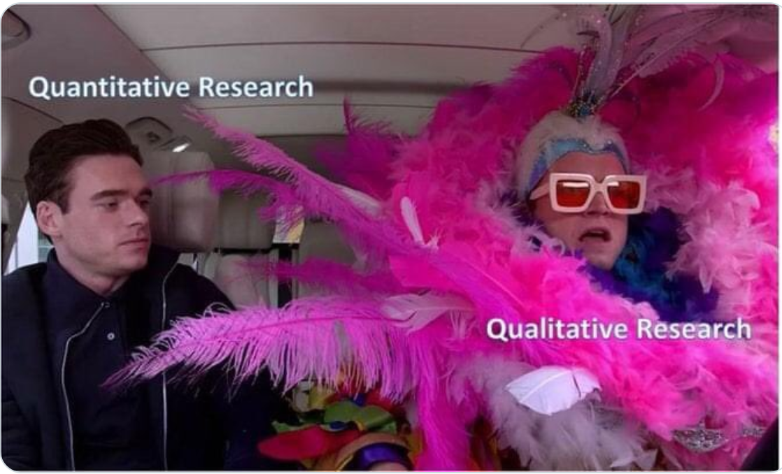
Establishing research infrastructure
Appointed as professor mso (maybe sort of) in 2012 to head the AAU part of Theme 3 over five years
Relatively young and inexperienced
Not part of original application - and the ideas in the application were loose and hard to realise
First ever cross-university digital infrastructure project in the humanities – closely monitored by deans from all universities
Trying to figure out the focus of the infrastructure – SDU worked with video – and many in the faculty did
Let’s try to rally some people around across the faculty that work with video and do something (Video Research Lab Aalborg – VILA (www.vila.aau.dk))
Also – let’s research PBL and the Aalborg PBL model
Other Universities theme
Our theme

Slide 12
Introducing the Aalborg PBL model

Slide 13
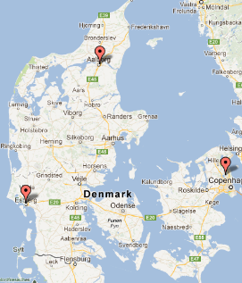
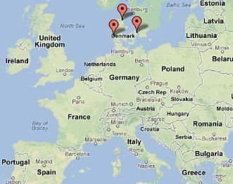
Aalborg University (AAU)
Located in three campuses in Denmark: Aalborg, Copenhagen, Esbjerg
Established in 1974 and from the beginning based on Problem Oriented and Project Based Work (The Aalborg PBL Model)
More about Aalborg PBL:
  https://www.en.aau.dk/about-aau/aalborg-model-problem-based-learning
  https://www.pbl.aau.dk/

Slide 14
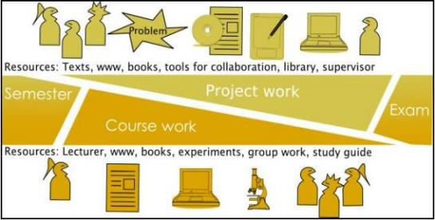
The Aalborg PBL model
50 %
Project work : a major project within a given subject-related framework determined for each semester (thematic framework).
Project related & mandatory courses supporting the project work
Evaluated as oral examinations based on the project report or through individual written or oral examinations.
Problem Based Learning
  Based on real-life problems
Project Organised Education
  Project work supported by lecture courses
Group Work
  groups of four to six students
  supervised by lecturers/professors
Interdisciplinary Studies
  Integration of theory and practice
  Focus on Learning to Learn and methodological skills
University Wide Model - Used in all faculties (with variations)
50 %

Slide 15

The Aalborg PBL-model – in short
Long-term collaboration 3-4 months (semester)
Students own and define the problem to work with
Students decide on methods, theory, empirial investigations (together with supervisor)
Solution – ”open ended”
Students write up an app. 60-100 page project report reflecting their work
An university-wide pedagogy – not short-term or single course

Slide 16
Problem Based Learning – the Process
Literature
Lectures
Group Studies
Problem Analysis
Problem Solving
Project Report
Tutorials
Field work
Experiments

Slide 17
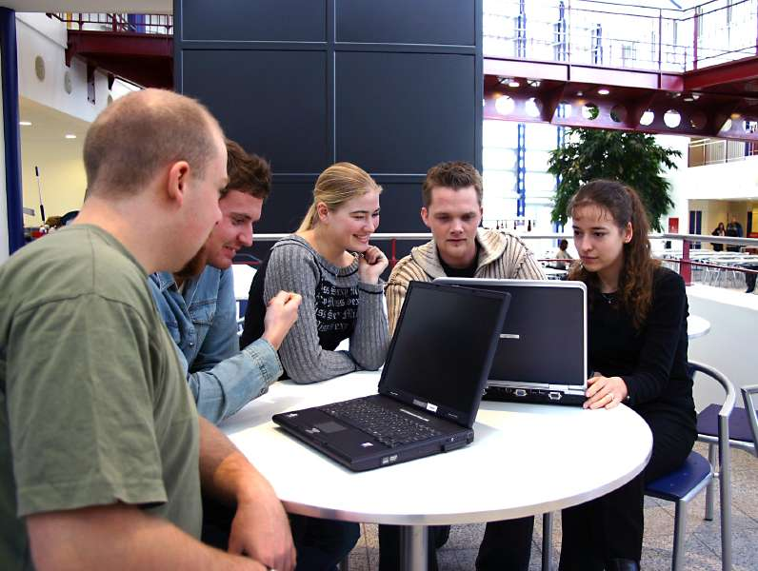
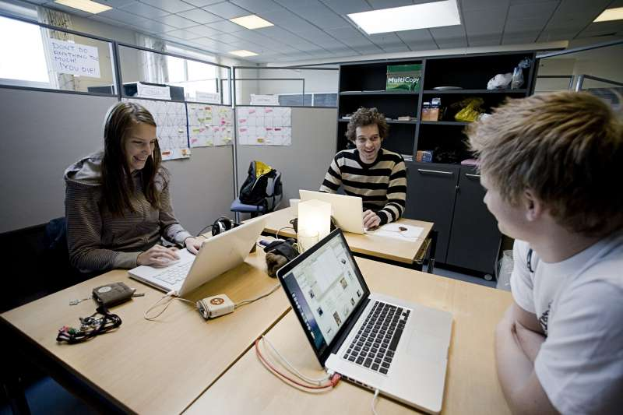

Slide 18
Questions or comments?

Slide 19

PBL research and video –
Background and interest
Overall intest in themes like knowledge transformation, collaboration and learning in small groups engaged in problem and project based learning (Aalborg PBL model)
We lack a deeper understanding of how students collaborate, learn and transform knowledge
  Can we better understand knowledge transformation, collaboration and learning by zooming in on bodily-material interaction
  Mostly focus on knowledge transformation within a context, but also we add some thoughts on across
Yuuuuge amount of video data – the greatest ever (many people have said that).
  Spring 2015: 34 days of project work of one BA group in Architecture and Design
  Autumn 2015: 14 days of 5 groups + 20 days for three groups
  Autumn 2018: 3 days of 5 groups (first round with 360 cameras)

Slide 20
Nomadic work and use of technology
Ryberg, T., Davidsen, J., & Hodgson, V. (2018). Understanding nomadic collaborative learning groups. British Journal of Educational Technology, 49(2), 235–247. https://doi.org/10.1111/bjet.12584

Slide 21
Nomadic work / Nomadicity
Long-term group collaboration rare in HE, but team work and nomadic work studied within CSCW (but learning not necessarily the focus)
Workers/learners who accomplish tasks across locations, but equally entails collaboration with others and can be distributed in time
Unlike ‘mobile workers’ nomadicity adds a layer of complexity as: “it involves both the movement of people and things but also the work in preparing for such movement and following the movement in creating conditions to engage with work and life activities.” (Ciolfi & Carvalho, 2014, p. 121)
Further, we are looking at work/learning with a ‘shared objective’ – unlike ‘hot deskers’ coordinating with others
Ryberg, T., Davidsen, J., & Hodgson, V. (2018). Understanding nomadic collaborative learning groups. British Journal of Educational Technology, 49(2), 235–247. https://doi.org/10.1111/bjet.12584

Slide 22
Nomadic work and nomadicity
In our work with the data, however, we developed these into three categories central to nomadic collaborative learning practices :
  ‘orchestration of work phases, spaces and activities’
  ‘orchestration of multiple technologies’
  ‘the orchestration of togetherness’.
Although similar they emphasise other aspects e.g. the interdependencies of place and time also suggested by Rossito et al. 2014

Slide 23
Data collection
Observed students in their learning environments
Conducted a two hour interview-workshop with students from both CDM (6th semester) and A&D (4th semester).
The interview-workshops were divided into three stages:
  basic introduction to the research
  questions on the students' experiences from their project work
  each of the students produced a poster explaining relations between space, tools and processes in their group work.
The interviews, posters and observation served as the main basis for the analysis and the paper
But video observations, impromptu in-situ interviews with the students, as well as casual observations as part of students inhabiting public working spaces and environments (we supervise student groups).

Slide 24
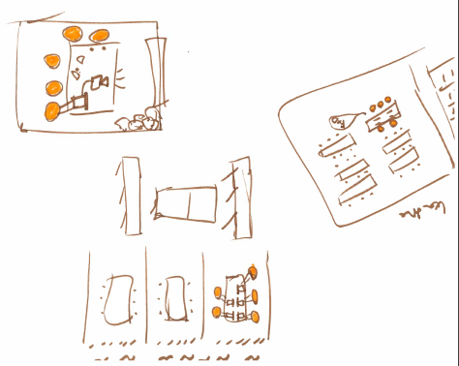
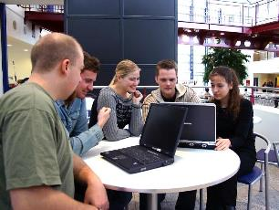
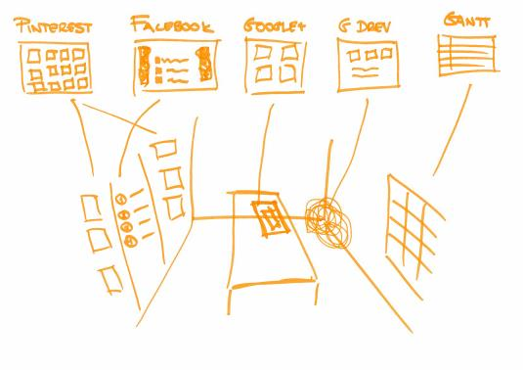
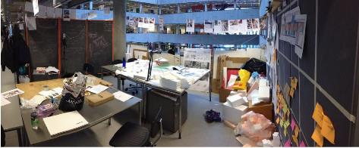

Slide 25
Orchestration of work phases, spaces and activities
Macro-temporal view of connections between work phases, spaces and activities (and tech)
Suggesting alternations btw collaborative and cooperative modes of work depending on phase in the project
Different spaces (and tech) for different activities

Slide 26
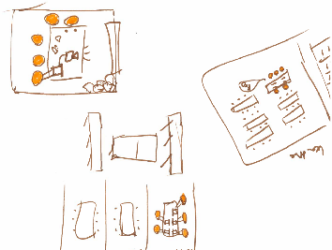
Orchestration of work phases, spaces and activities
Where to work during different phases present in other visualisations
Suggesting however a more fluid pattern of daily decisions
Continous balance of needs, tasks, spaces and technologies in relation to each other
Silence, a projector, post-its, working together or alone – shifting needs considered in finding appropriate spaces
“Well, we used it a lot right after a lecture or the like … Then we just sat in the cantina area and got on top of tasks for tomorrow. So it was more like the minor task we sorted there, and then you could book a group room for the next day if necessary.” (Student 3, CDM, Interview)

Slide 27
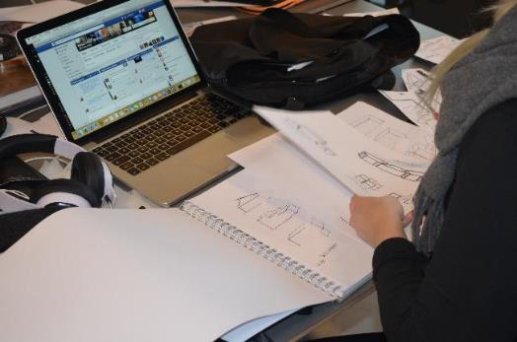
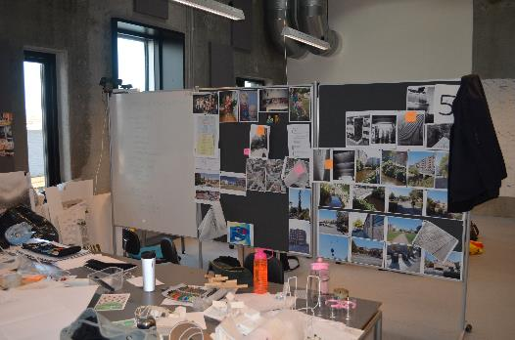
Orchestration of multiple technologies
Digital technologies pervasive but also ‘physical’ and non-digital artefacts - pens, post-its, paper, and blackboards
Composite or hybrid uses of technology - transpositions:
  digital mindmaps are remade, re-enacted and restructured on post-it notes and paper
  overview of tasks in a Google Docs reorganised on blackboard to be re-inscribed in Google Docs.
  Pinterest: Photos they “pin” digitally are also printed on paper and hung on wires and notice boards in their studio
    Reorganised as design ideas change
Students orchestrate work and technology in different social constellations:
  Individually, in smaller groups or whole group - alternate between cooperative and collaborative modes of work

Slide 28
The orchestration of togetherness
Students orchestrate work and technology in different social constellations: individually, in smaller groups or whole group - alternate between cooperative and collaborative modes of work
Digital technologies important in coordinating this work – ‘always on’ via FB messenger and using ‘likes’ to indicate ‘read’ or meet in hybrid ways – some co-present others via skype
Groups dependent on each other and maintaining good social relations and presence – particularly challenging when working together apart
Need to negotiate and orchestrate their idea of and preferred ‘constellations of togetherness’
Social processes in complex and composite ‘constellations of togetherness’ are an important part of learning within nomadic groups
Topic for further research – how do they manage the work of maintaining social cohesion and co-presence?

Slide 29
Key messages
Response to need for closer empirical scrutiny of what students ‘actually do’
‘nomadicity’ and ‘nomadic work’ useful lenses to understand students’ self-organised collaborative learning across sites
Complex entanglements of space, time, activities, and technologies to manage in nomadic collaborative learning groups
  Improvisational dances of which technologies to use, but also in what spaces particular technologies and activities are meaningful - often dependent on the processual aspects
Fluid boundaries between the 'digital' and 'physical’ and transpositions – distinction superfluous?
  Focus on ‘digital’ might overlook important aspects of practices in nomadic collaborative groups
Orchestration of togetherness an important area of future studies – how to manage working together apart
Complex work where students – we find – are developing valuable collaborative competencies in managing nomadic collaborative group learning

Slide 30
Questions or comments?

Slide 31
Knowledge forms in students’ collaborative work: PBL as a design for transfer

Slide 32
Knowledge forms in students’ collaborative work - PBL as a design for transfer
Chapter: Analyse video data from a long-term, collaborative problem-based project work conducted by a group of Architecture and Design (A&D) students within the frame of the Aalborg PBL model.
  Selected brief video clips from students’ preparation for a Review Session (particular format)
Main purposes:
  To understand the close connections between talk, bodily-material interaction and artefacts in students’ interactions and emphasise importance of the material surroundings
  To analyse and understand the different knowledge forms embedded and emerging in these interactions
  To analyse and discuss the connections between the overarching pedagogy (Aalborg PBL model), the “epistemic design game” of the formal/informal review sessions and the embodied interaction
Ryberg, T., Davidsen, J. G., & Bernhard, J. (2019). Knowledge forms in students’ collaborative work: PBL as a design for transfer. In N. B. Dohn, S. Børsen Hansen, & J. J. Hansen (Eds.), Designing for Situated Knowledge Transformation (pp. 127–144). Routledge. https://doi.org/10.4324/9780429275692-8
Ryberg, T., Davidsen, J. G., & Bernhard, J. (2019). Knowledge forms in students’ collaborative work: PBL as a design for transfer. In N. B. Dohn, S. Børsen Hansen, & J. J. Hansen (Eds.), Designing for Situated Knowledge Transformation (pp. 127–144). Routledge. https://doi.org/10.4324/9780429275692-8

Slide 33
Exploring two analytic themes:
“Embodiment – the intimacy of talk, gestures and artefacts” and
  How the bodily-material handling of a styrofoam model can be viewed as an example of “practical knowledge” that transgresses a merely “communicative” or “illustrative” purpose.
“The material, collective history of the group and the production of shared artefacts and practices”.
  Analysing the physical surroundings the students work in and we argue that the students develop “experiential knowledge” as patterns of practice for organising their work, organising the studio and working with models
With particular interest in the pedagogical framework of the “Aalborg PBL model” within which the students’ activities are situated (specific discussion of levels of contexts can be found in chapter)

Slide 34
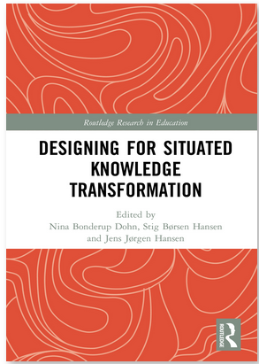
Knowledge forms
Propositional knowledge
  “knowledge expressing a true proposition, i.e. a true and suitably qualified statement about the world”
Procedurally realized routines
  “relative clearly definable action sequences which lead to specifiable, predictable results. Walking, riding a bike”
Practical knowledge
  “also called skill or ‘know how’, is the skillful mastering of action within a domain”
Experiential knowledge
  “‘know of’, ’knowledge by acquaintance’ or ‘knowledge of familiarity’ - the grasp of a phenomenon that comes from having experienced it directly […] examples are knowing what a certain color (e.g. mauve) looks like; what a certain instrument (e.g. the clarinet) sounds like”
Episodic knowledge
  “the remembrance of a specific incident or event as one (believes one) experienced it at the time of its happening, most often with vivid details”
https://www.taylorfrancis.com/books/edit/10.4324/9780429275692/designing-situated-knowledge-transformation-nina-bonderup-dohn-stig-b%C3%B8rsen-hansen-jens-j%C3%B8rgen-hansen?refId=82a32d80-4b04-41f8-8500-fe48031886d9

Slide 35
More specific context of data
Six students from Architecture and Design 5. semester (2015)
Designing a ‘real office building’ (school world ←→ engineering / arch world) – theory through practice
Six weeks project (unlike regular semester project) – after 2 weeks a review session / status seminar
  Two days before seminar they start planning for presenting concept at seminar
  Group is preparing for a status seminar / review session next day where they are to present their concept(s)
  They have worked in subgroups of two
  Now sub-groups present to each other
    their concept (with drafts– digital & analog) is presented to the other team members
  The other members provide feedback and critique
    Own concepts and former ideas are brought into play

Slide 36
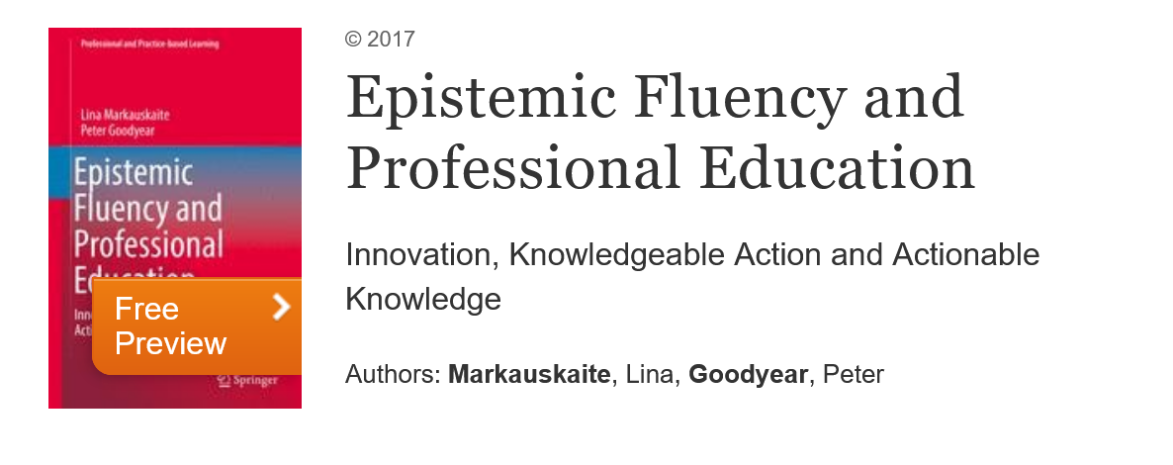
Epistemic practice – epistemic design games
A Babushka doll of Epistemic practices and epistemic design games
Students working as ‘Archictectural engineers’ for a client – put in teams – real-world problem and design
Have their own studio →
Review sessions an important professional practice – incorporated into the semester as important pedagogical element for developing professional identity
Students remaking review sessions – in groups of two they present to others and receive crititque and the co-develop proposals
https://www.springer.com/gp/book/9789400743687

Slide 37
Analysis

Slide 38
Embodiment – the intimacy of talk, gestures and artefacts
Handling a styrofoam model and explaining design ideas
Talk, gestures and handling of artefacts interwoven and inseparable (talk alone would make little sense)
An example of ”procedurally realised routines” (as writing with a pen) “clearly definable action sequences leading to specifiable events”?
We argue: an example of “practical knowledge” transgressing merely “illustration” - a way of “building an argument” within a design process.
Instead “practical knowledge” i.e. as “skilful mastering of action within a domain or a skill exercised as multifaceted response to specific circumstances”
Forms of “practical knowledge” that are important patterns of “designerly” practices, or particular elements of the epistemic game of “design practice”

Slide 39
Material, collective history
Forms of knowledge are also about organizing and designing artefacts and surroundings relevant to particular practices
Studio an intimate part of the students’ knowledge and collective memory - instrumental in developing knowledge and new ideas.
Design and organisation of studio important - areas for calendars and tasks, areas for computerised sketches, for shapes, for various design ideas, and for models.
The spatial arrangement and the categorisations are part of the group’s “knowledge” or rather a resource for their active “knowing”.
Students develop “practical knowledge” as patterns of practice for organising their work, organising the studio, working with models and engaging with epistemic games (carrying into their own work the pedagogical structure of the formal review session as informal peer-review sessions.)
Patterns of practice are important in actualising and situating, for example “models” within a particular practice

Slide 40
Concluding remarks
Handling a model is important “pattern of practice” in the “epistemic game” of designing. Part of “know how” in terms of how to explain and argue for a design, i.e. are part of the students’ “practical knowledge”.
Extends to the design and organisation of physical surroundings, and the organisation and planning of activities – equally “practical knowledge” or patterns of practice that are part of particular epistemic games.
Aspects easy to overlook due to “commonsensiness” but are complex knowledge forms uniquely situated within a particular professional practice
In analysis: Glimpses of how such skills develop in practice. How knowledge is transformed and deepened through the students’ embodied interaction with each other, the artefacts and the surroundings
These knowledge forms do not develop in a vacuum. Facilitated by the pedagogical model of AAU-PBL, the more specific pedagogical adoption of “formal review sessions”, as well as the students’ own adoption of peer-review sessions.
The PBL model allows students to work on their own projects over a lengthy period:
  Encourages students to work with real-life problems.
  Encourages to develop own ways of organising the work and socio-material surroundings,
  Allow them to engage in concrete design practices, such as building and discussing models and sketches

Slide 41
Ecotones as an analytic lens to understand students’ work

Slide 42
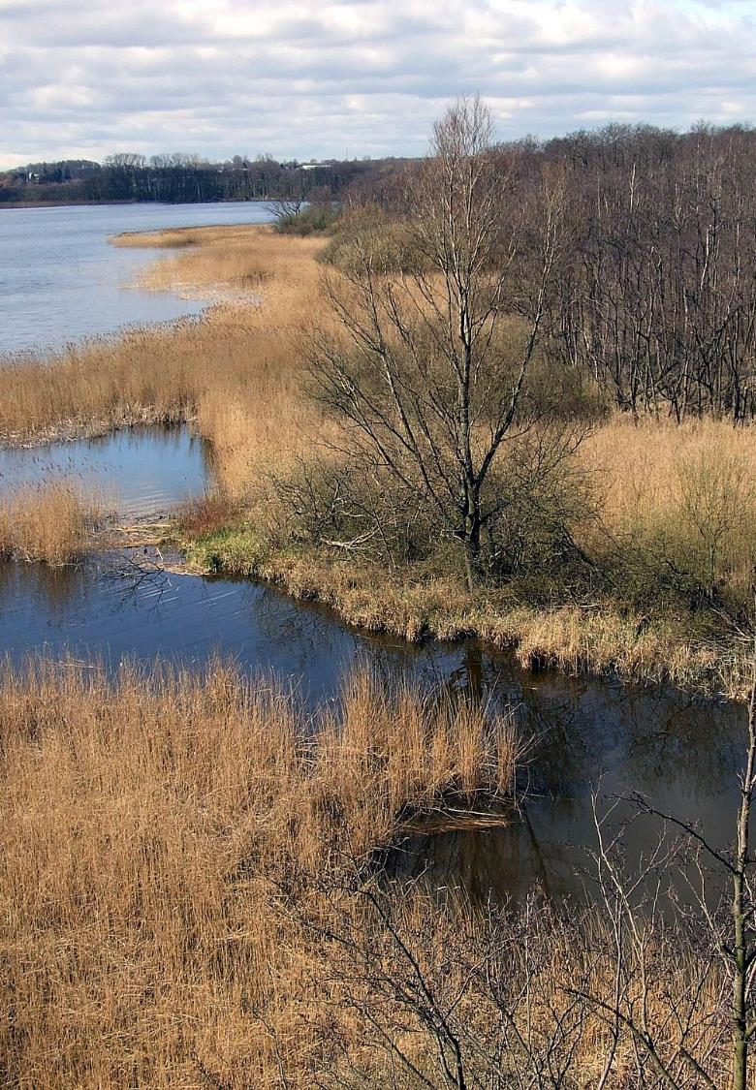
Ecotones as analytic lens
Why ecotones
The notion of Ecotones
Characteristics of Ecotones
Examples from the analysis
What does it help us do?
Ryberg, T., Davidsen, J., Bernhard, J. et al. Ecotones: a Conceptual Contribution to Postdigital Thinking. Postdigit Sci Educ (2021). https://doi.org/10.1007/s42438-020-00213-5
Image credit Günther Klug https://en.wikipedia.org/wiki/Ecotone#/media/File:Blick_vom_L%C3%B6ns_Turm_HemmelsdorferSee_Ausfluss_aalbek.jpg

Slide 43
Why Ecotones
Therefore, the postdigital is about dragging digitalisation and the digital—kicking and screaming—down from its discursive celestial, ethereal home and into the mud.
It is about rubbing its nose in the complexities of everyday practice, such as managing a class of 7-year olds working on tablets (half of them not charged and the other half with links to dubious sites); the realities of gender or racial bias of algorithms or how notions of imagined efficiency gains brought about by ‘the digital’ impact on work-life balance in organisations.
Dissatisfaction with dichotomies such as analogue/real/material vs. online/virtual/digital
Concern also with ‘digitalisation’, ‘digital competences’, ‘digital X’
Vilification or romantisation of ‘the digital’
Both tend to overlook the complex ways in which we are already deeply ‘digital’ and how the digital weaves itself into the tapestry of everyday life
Ecotones as an analytic concept to dissolve or easen perceived contradictions
Jandrić, P., Ryberg, T., Knox, J., Lacković, N., Hayes, S., Suoranta, J., Smith, M., Steketee, A., Peters, M., McLaren, P., Ford, D. R., Asher, G., McGregor, C., Stewart, G., Williamson, B., & Gibbons, A. (2018). Postdigital Dialogue. Postdigital Science and Education. https://doi.org/10.1007/s42438-018-0011-x
The postdigital is hard to define; messy; unpredictable; digital and analog; technological and non-technological; biological and informational. The postdigital is both a rupture in our existing theories and their continuation. However, such messiness seems to be inherent to the contemporary human condition. (Jandrić et al. 2018: 895)

Slide 44
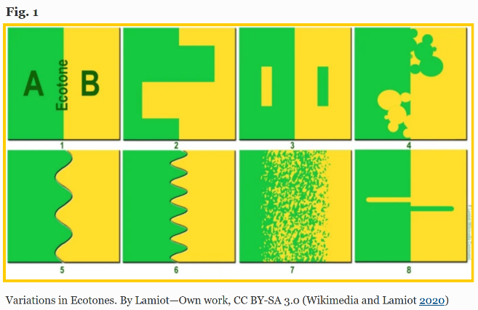
The notion of ecotones
Ecotone, a transitional area of vegetation between two different plant communities, such as forest and grassland. It has some of the characteristics of each bordering biological community and often contains species not found in the overlapping communities. […] The influence of the two bordering communities on each other is known as the edge effect. An ecotonal area often has a higher density of organisms of one species and a greater number of species than are found in either flanking community. (Encyclopaedia Britannica 2020)
Adopted from biology/ecology
  ”Ecotone, a transitional area of vegetation between two different plant communities, such as forest and grassland.”
  “An ecotone is a transition area between two biomes. It is where two communities meet and integrate.”
Found this to be an interesting metaphor to explore distinctions such as digital vs analogue/material/real
Particularly, because the lines we draw between the two seem to differ, much like the lines between ecotones (see figure)
An ecotone is a transition area between two biomes. It is where two communities meet and integrate. […] An ecotone may appear on the ground as a gradual blending of the two communities across a broad area, or it may manifest itself as a sharp boundary line. (Wikipedia 2020)

Slide 45
Characteristics of Ecotones
In the paper we argue (based on other adaptations of the concept in the literature):
  Ecotones have affective and conceptual dimensions and are characterised by tension and diversity.
  Ecotones have spatial and material aspects and have generative or innovative properties.

Slide 46
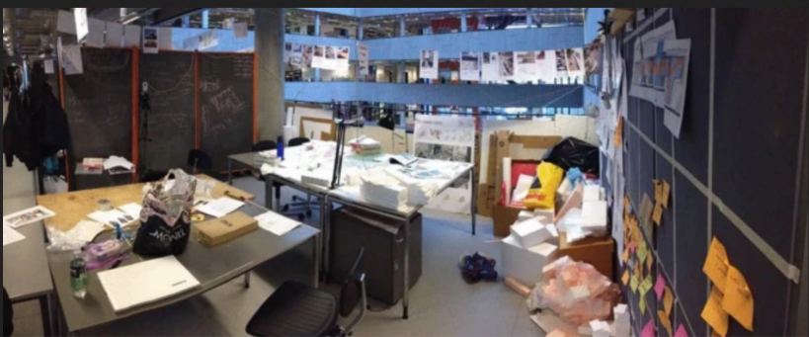
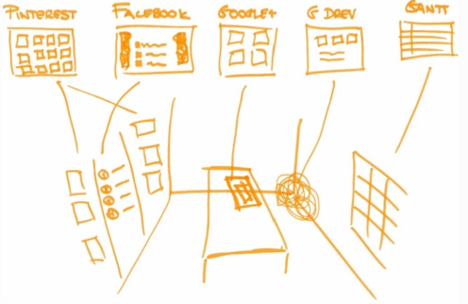
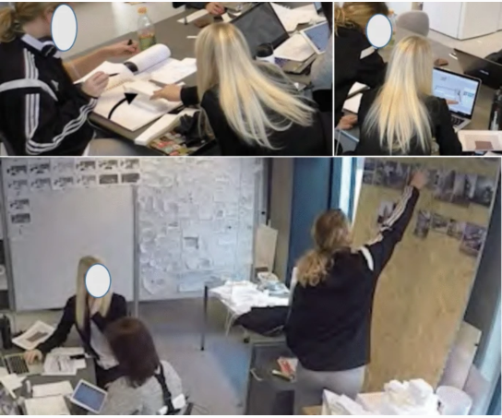
Examples from the analysis
Use of digital technology is widespread and woven into everyday practices that makes it quite hard to separate the ‘digital’ from the ‘analogue’
  Group room digital overlays, but digital also occupies space
  Pinterest-pictures
  Models and transpositions
  Is a digital picture printed digital or analogue?
  Seamless movement between analogue and digital →
A rich and varied ecology emerge in the mixture and usually the ecotone is a bit of a mess
  But also tensions (analogue sketching vs digital models)

Slide 47
What does it help us do?
Ecotones have affective and conceptual dimensions and are characterised by tension and diversity.
Ecotones have spatial and material aspects and have generative or innovative properties.
Provides alternative analytic lens to discuss and analyse the use of digital technologies in students’ work
Help us understand tensions and when ‘the digital’ emerge as a ‘problem’ or ‘contradiction’ and when it lives a harmonious life together with other inhabitants in the ecotone
But also a troublemaker – how should we understand the digital in digital competences…what are these even? Can it help us understand this better I wonder
Possibly, a deeper understanding of Ecotones as a biological/ecological concept can give us a richer metaphorical lens to look at use of technology: ‘species’, ‘faune’, ‘ecology’
Just started to look at it….

Slide 48
Where it is going (newer developments)

Slide 49
Connective etnography – understanding hybridity
- Work by Mia Thyrre Sørensen

Slide 50
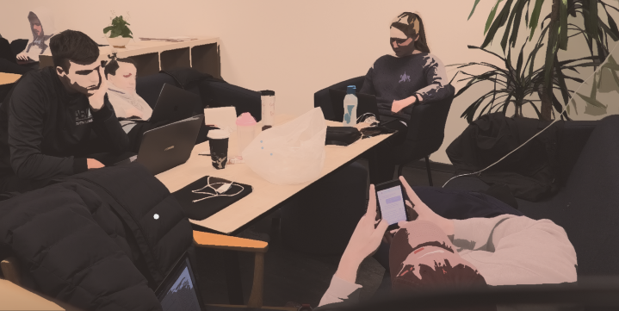
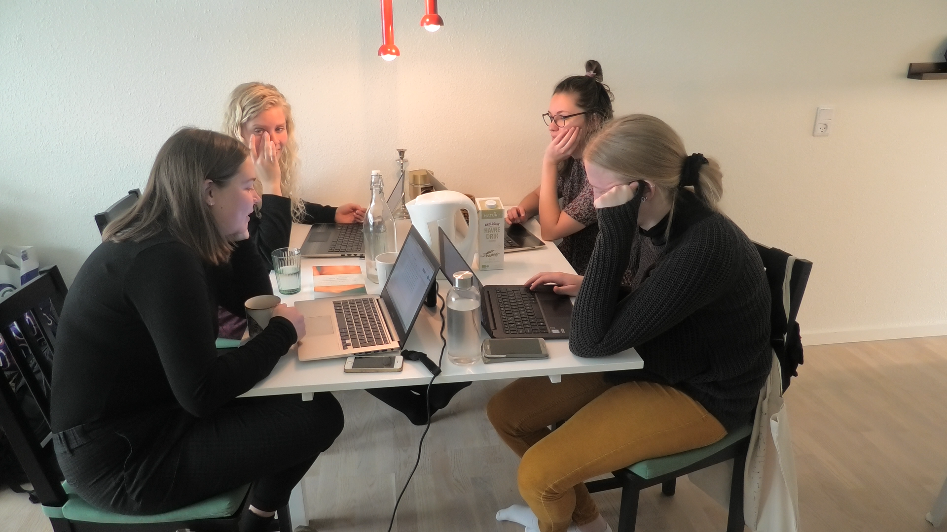
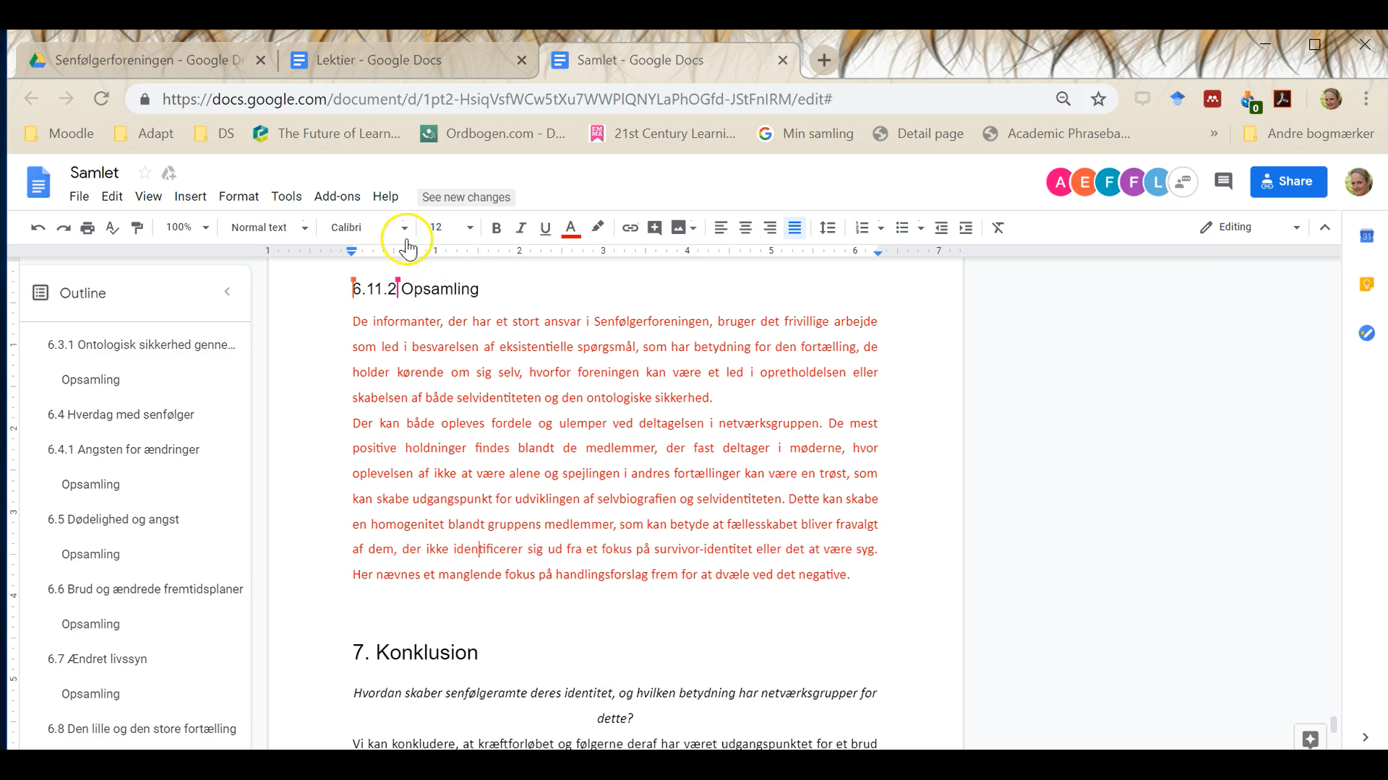
PBL collaboration in hybrid learning environment
Presentation: Results from an ethnographical study of student PBL collaboration across physical and digital field sites (before COVID-19)
  Diversity in PBL collaboration
  Ongoing negotiation of work constellations, sociablity and technology
  Four types of presence
Intention: encourage to show curiosity and interest in how the students collaborate
Sørensen, M. T. (2018). The Students’ Choice of Technology A pragmatic and outcome-focused Approach. In D. Kergel, B. Heidkamp, P. K. Telléus, T. Rachwal, & S. Nowakowski (Eds.), The Digital Turn in Higher Education: International Perspectives on Learning and Teaching in a Changing World (pp. 161–174). Springer Fachmedien Wiesbaden. https://doi.org/10.1007/978-3-658-19925-8_12
Slides from Mia Thyrre Sørensen

Slide 51
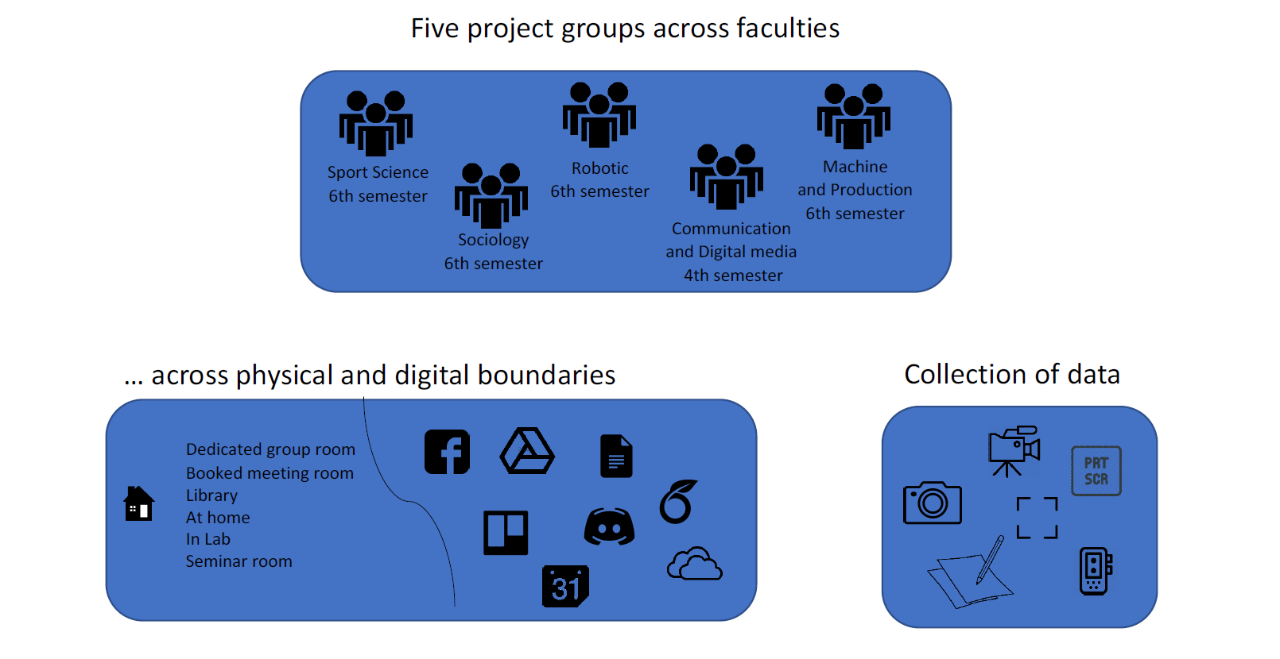
Data collection
Connective etnography
Across sites, across modalites – follow the actors…
Model from Mia Thyrre Sørensen

Slide 52











Diversity in PBL collaboration
Communication and Digital Media
Members: 3 males + 3 female
Robotic
Members: 4 males
5 PBL groups
Technology:
Technology:
+ disciplin-specific software
+ discipline-specific software
Varied through the project period
Daily meetings
Meeting rooms, open study area
Group room, laboratory, Virtual meetings, seminar rooms
Sociology
Members: 4 females
Sport Science
Members: 2 males + 2 female
Machine and Production
Members: 3 males + 1 female
Choice and use of technology
Meeting frequency
Meeting spaces
Technology:
Technology:
Technology:
+ disciplin-specific software
+ discipline-specific software
Weekly meetings
Ad-hoc planning
Daily meetings
Home, booked
meeting room
Group room, laboratory, seminar rooms
Meeting rooms, library
Slides from Mia Thyrre Sørensen

Slide 53
Big Video: 360 video and VR (ava360vr)
Work from Jacob Davidsen and Paul McIlvenny

Slide 54
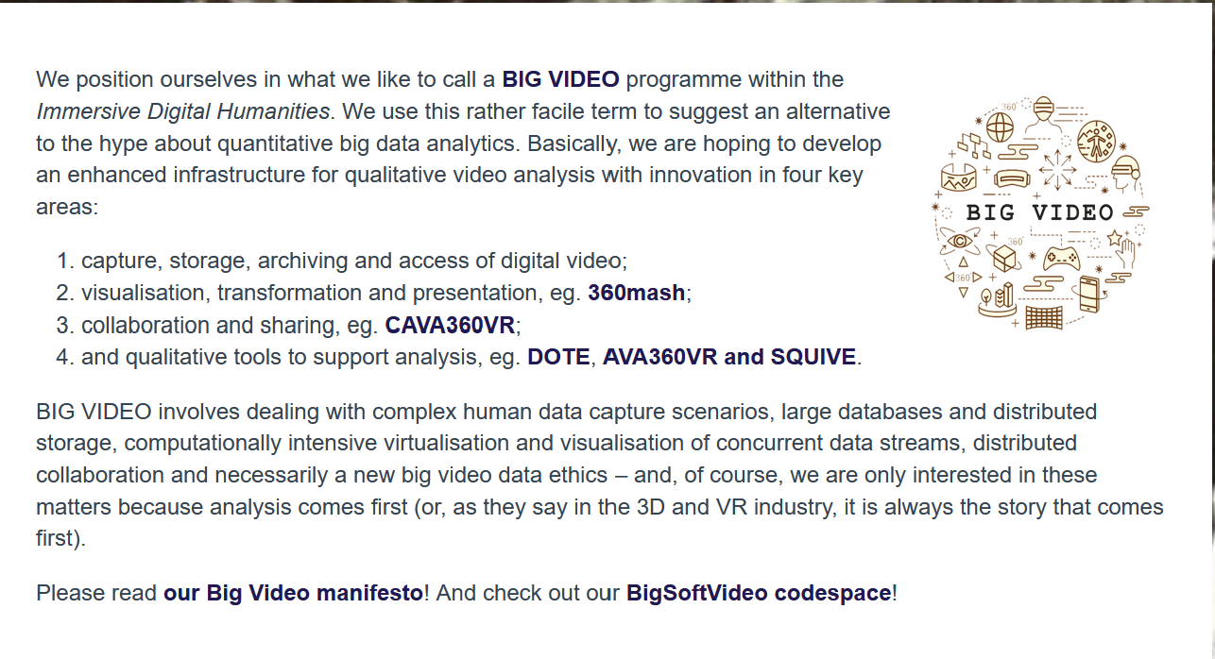
Video based research
From VILA developed also Big Video
www.bigvideo.aau.dk
www.bigvideo.aau.dk
Software, support and theoretical / methodological development
Particularly AVA360VR might be of interest to you (I take NO credit for this work!!!)

Slide 55
Visualisations of the concept
Big data
Meta-data
Quantitative
Big video
Human data
Qualitative
Enhanced digital video
Large data sets
Complex data streams
BIG VIDEO
INFRASTRUCTURE
Collaboration
Sharing
Visualisation
Transformation
Presentation
Qualitative tools
to support analysis
Capture
Storage
Archiving
Access
Models from Jacob Davidsen and Paul McIlvenny

Slide 56
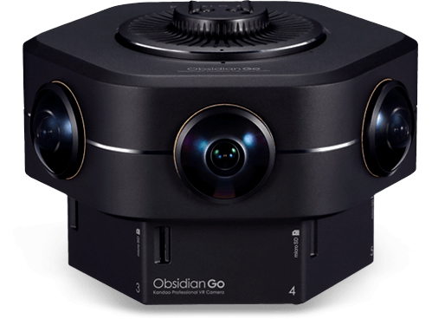

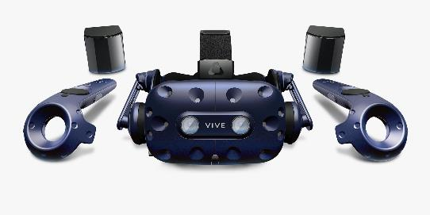
Technological developments
Slides from Jacob Davidsen
Slides from Jacob Davidsen

Slide 57
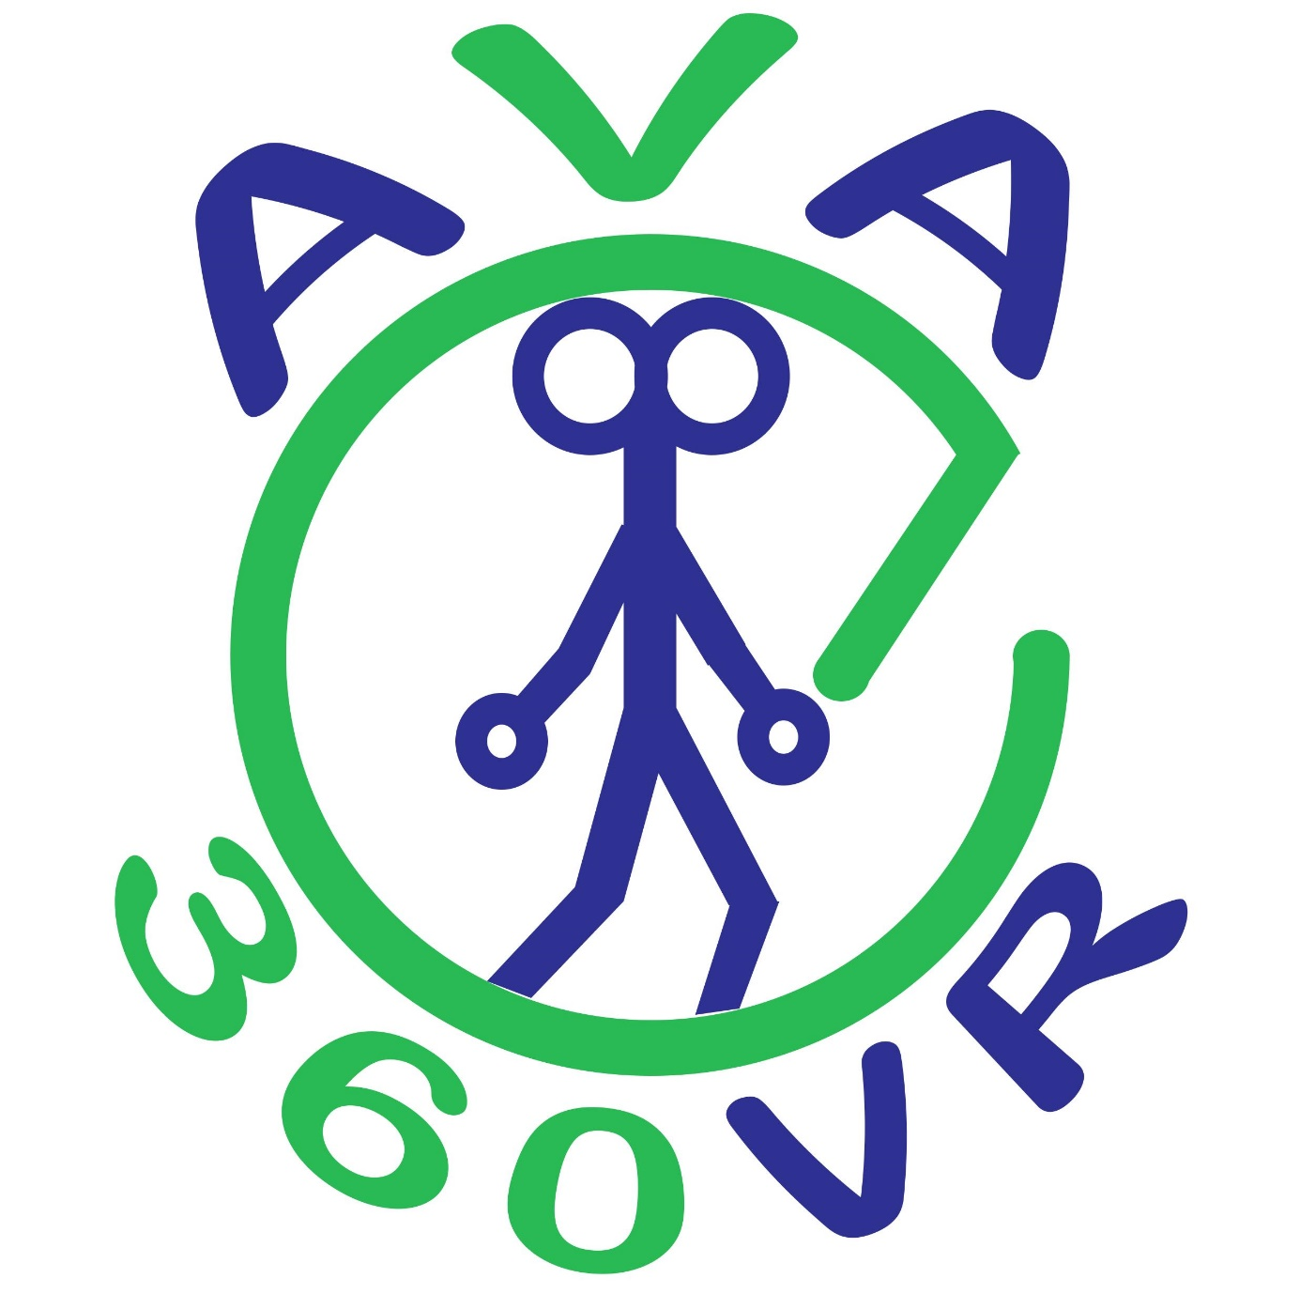


AVA360VR
Slides from Jacob Davidsen
Slides from Jacob Davidsen

Slide 58
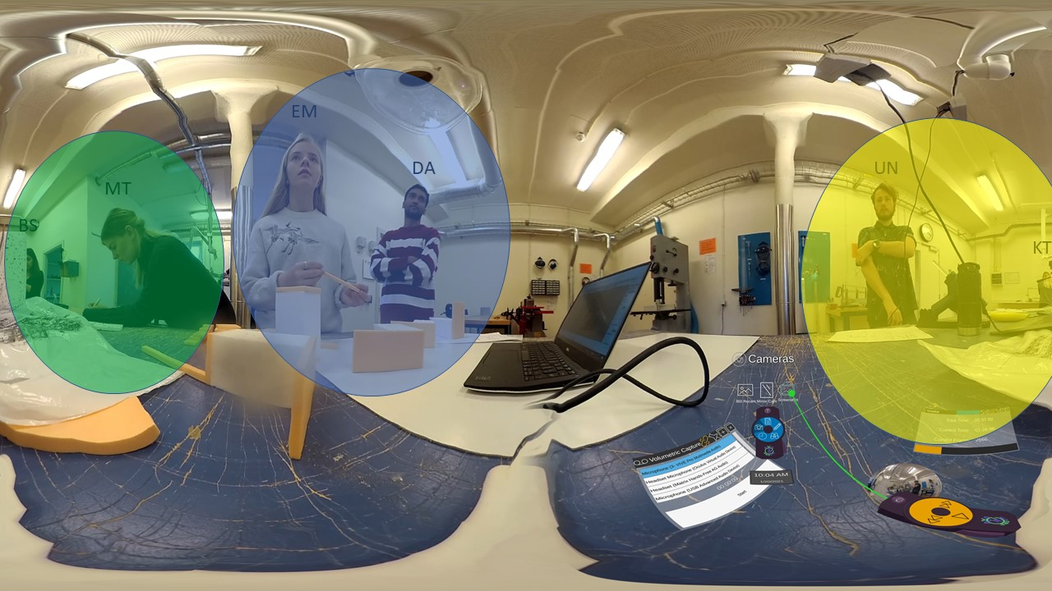
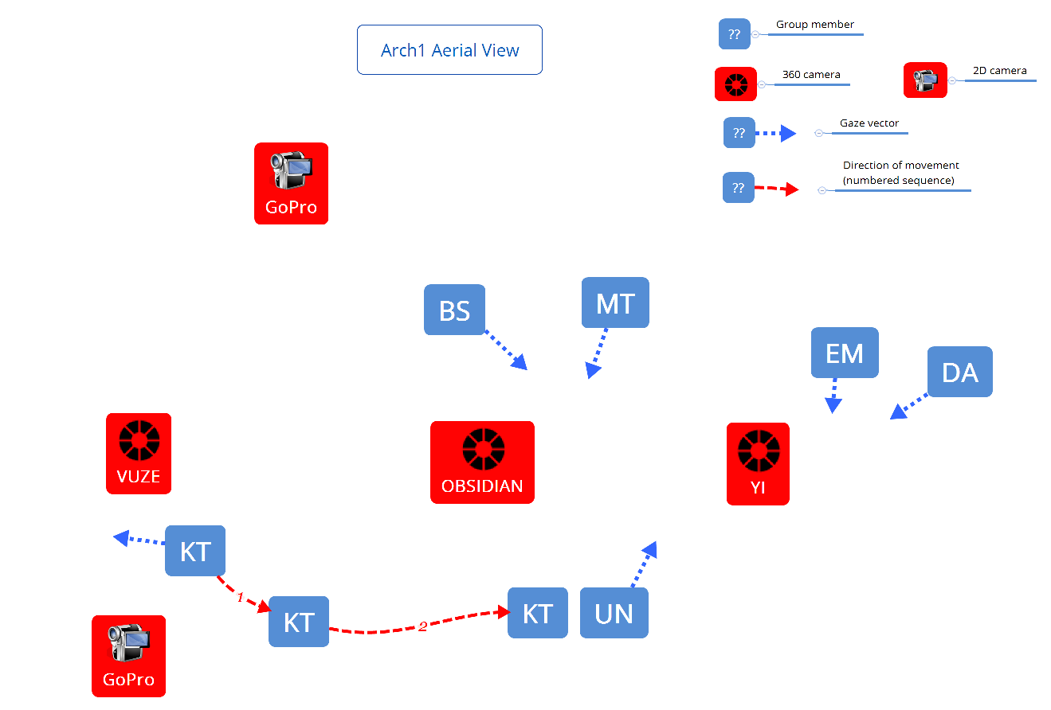
Introducing the data
Slides from Jacob Davidsen
Slides from Jacob Davidsen

Slide 59
Video example of AVA360VR
https://dighumlab.org/case-ava360vr/
See much more on: www.bigvideo.aau.dk

Slide 60
Download AVA360VR
https://bigsoftvideo.github.io/AVA360VR/

Slide 61
References
Publications on our Architecture and Design study
Bernhard, J., Carstensen, A.-K., Davidsen, J., & Ryberg, T. (2019). Practical Epistemic Cognition in a Design Project-Engineering Students Developing Epistemic Fluency. Ieee Transactions on Education, 62(3), 216–225. https://doi.org/10.1109/TE.2019.2912348
Bernhard, J., Davidsen, J., Ryberg, T., Carstensen, A.-K., & Abildgaard, J. R. (2018). Engineering students’ shared experiences and joint problem solving in collaborative learning. 46th SEFI, 2018 Conference Procedings. http://www.sefi2018.eu/
Davidsen, J., Ryberg, T., & Bernhard, J. (2020). ‘Everything comes together’: Students’ collaborative development of a professional dialogic practice in architecture and design education. Thinking Skills and Creativity, 37, 100678. https://doi.org/10.1016/j.tsc.2020.100678
Ryberg, T., Davidsen, J., Bernhard, J., & Larsen, M. C. (2021). Ecotones: A Conceptual Contribution to Postdigital Thinking. Postdigital Science and Education, 3(2), 407–424. https://doi.org/10.1007/s42438-020-00213-5
Ryberg, T., Davidsen, J. G., & Bernhard, J. (2019). Knowledge forms in students’ collaborative work—PBL as a design for transfer. In N. B. Dohn, S. B. Hansen, & J. J. Hansen (Eds.), Designing for Situated Knowledge Transformation (pp. 127–144). Routledge.
BigVideo publications
McIlvenny, P. B. (2018). Inhabiting spatial video and audio data: Towards a scenographic turn in the analysis of social interaction. Social Interaction. Video-Based Studies of Human Sociality, 2(1). https://doi.org/10.7146/si.v2i1.110409
McIlvenny, P. B. (2020). The future of ‘video’ in video-based qualitative research is not ‘dumb’ flat pixels! Exploring volumetric performance capture and immersive performative replay. Qualitative Research, 146879412090546. https://doi.org/10.1177/1468794120905460
McIlvenny, P. B., & Davidsen, J. (2017). A Big Video Manifesto: Re-sensing Video and Audio. Nordicom Information, 39(2), 15–21.

